Slide 1


Titolo presentazione sottotitolo
Numerical Methods – Project 1
Group 1
Manfred Nesti
Luca Caivano
Bruno Ursino
Alessandro Pegurri
Valeria Pajola
Chiara Vitale
Andrea Della Libera
Milano, XX mese 20XX

Slide 2
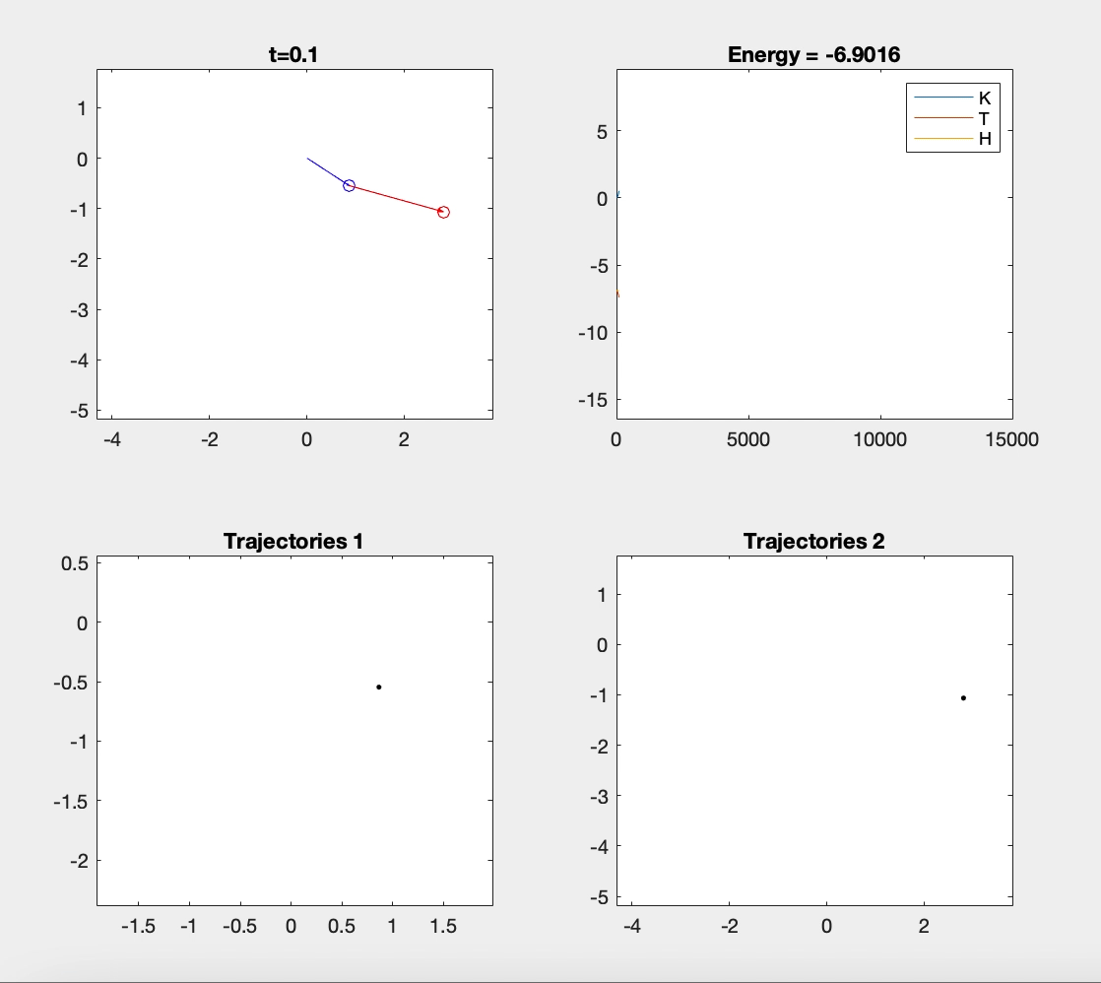
ASSIGNMENT 1 - task Implementation of elastic double pendulum using position Verlet algorithm

Slide 3
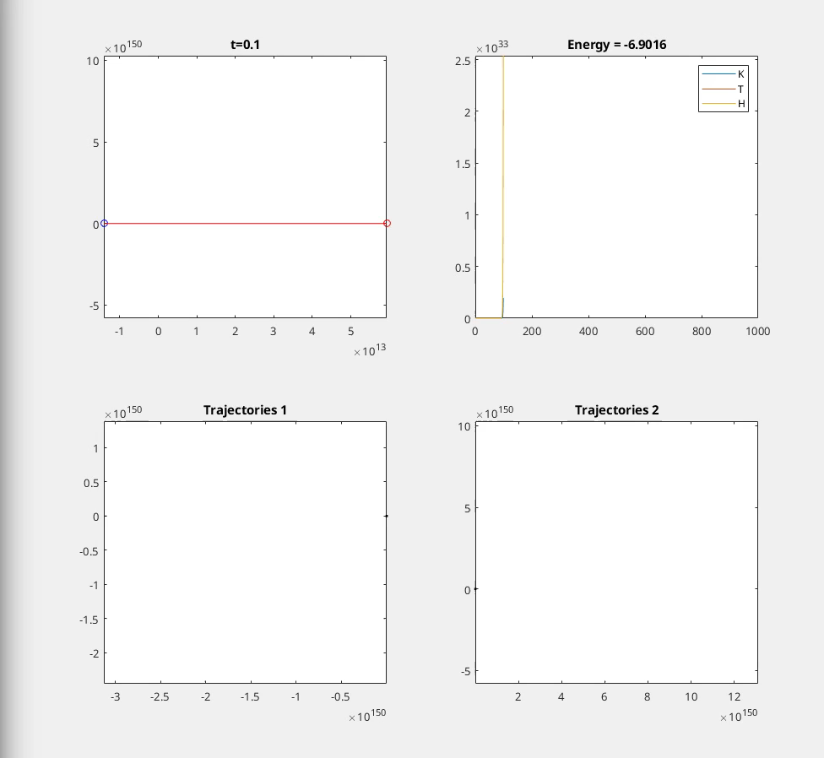
ASSIGNMENT 1 Implementation of elastic double pendulum using position Verlet algorithm Very high k

Slide 4
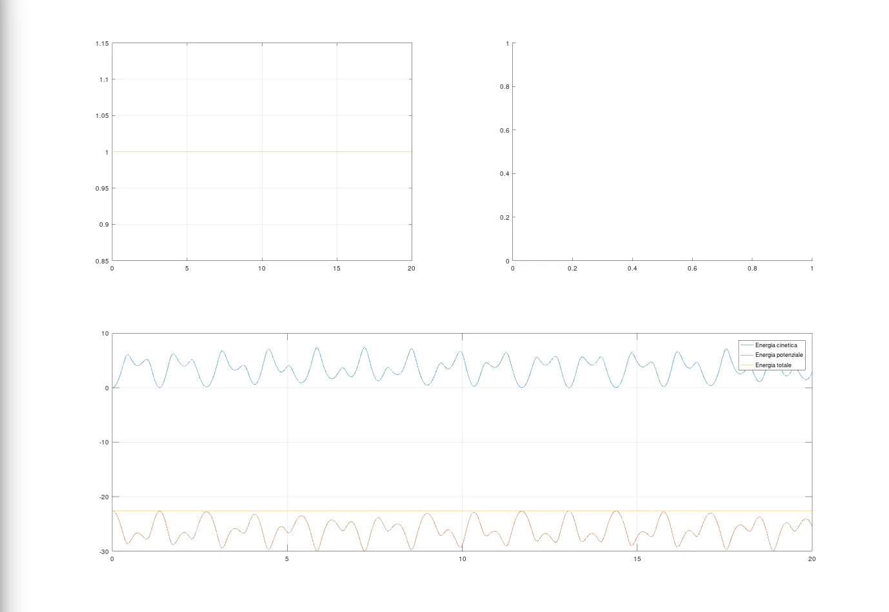
ASSIGNMENT 2 - task Implementation of rigid links double pendulum using SHAKE’s algorithm

Slide 5
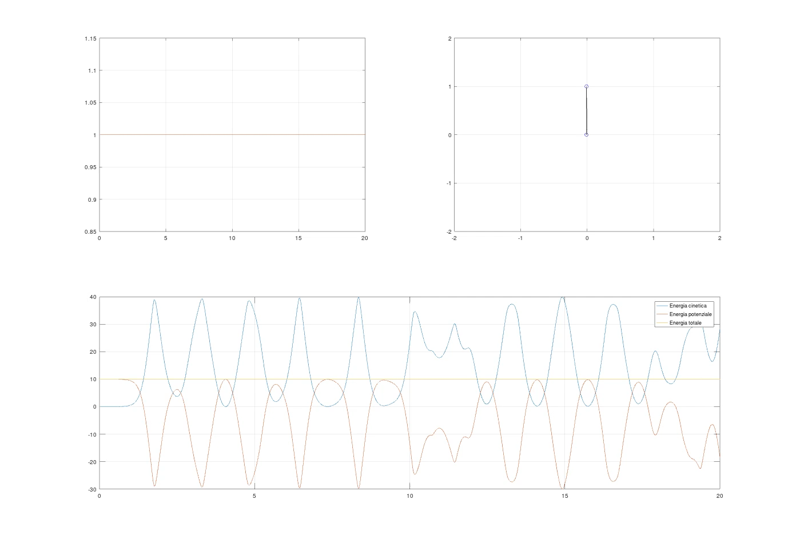
ASSIGNMENT 2 A different initial condition

Slide 6
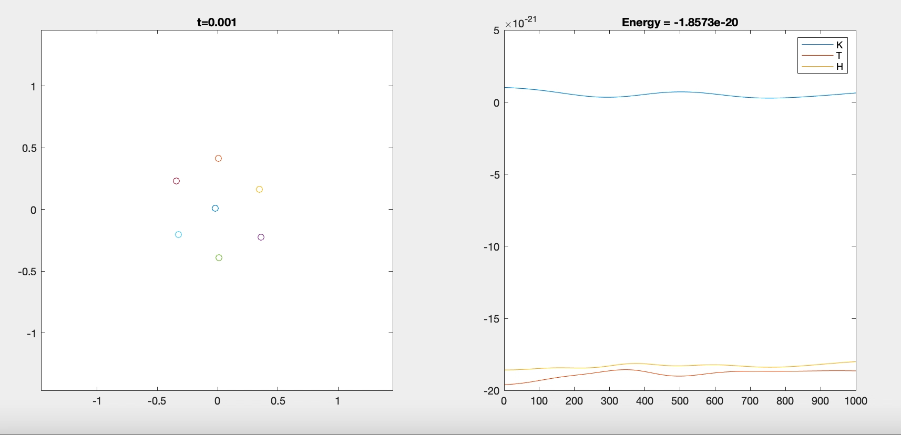
ASSIGNMENT 3 - task Application of the Position Verlet method for frozen Argon crystal

Slide 7
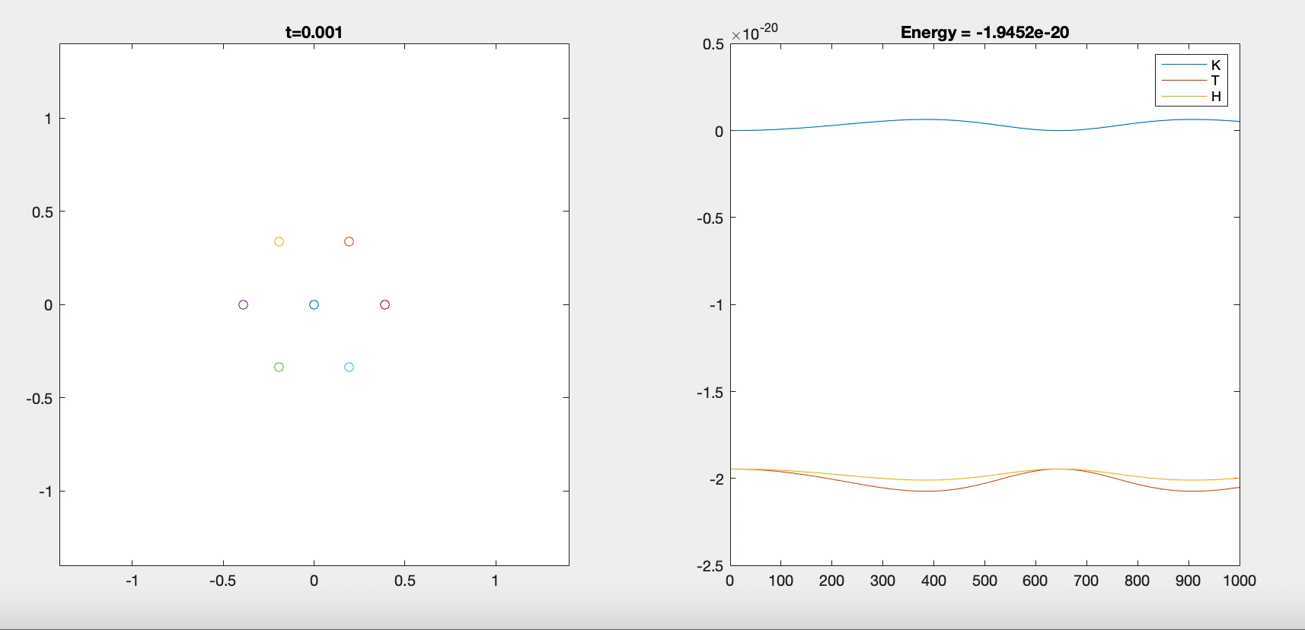
ASSIGNMENT 3 Argon crystal with null initial velocities

Slide 8
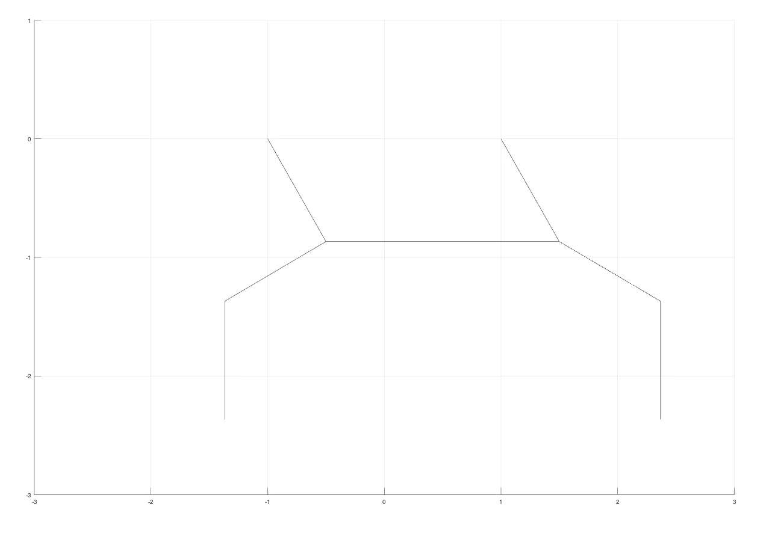
Further implementations of SHAKE’s algorithm Two double pendulums

Slide 9
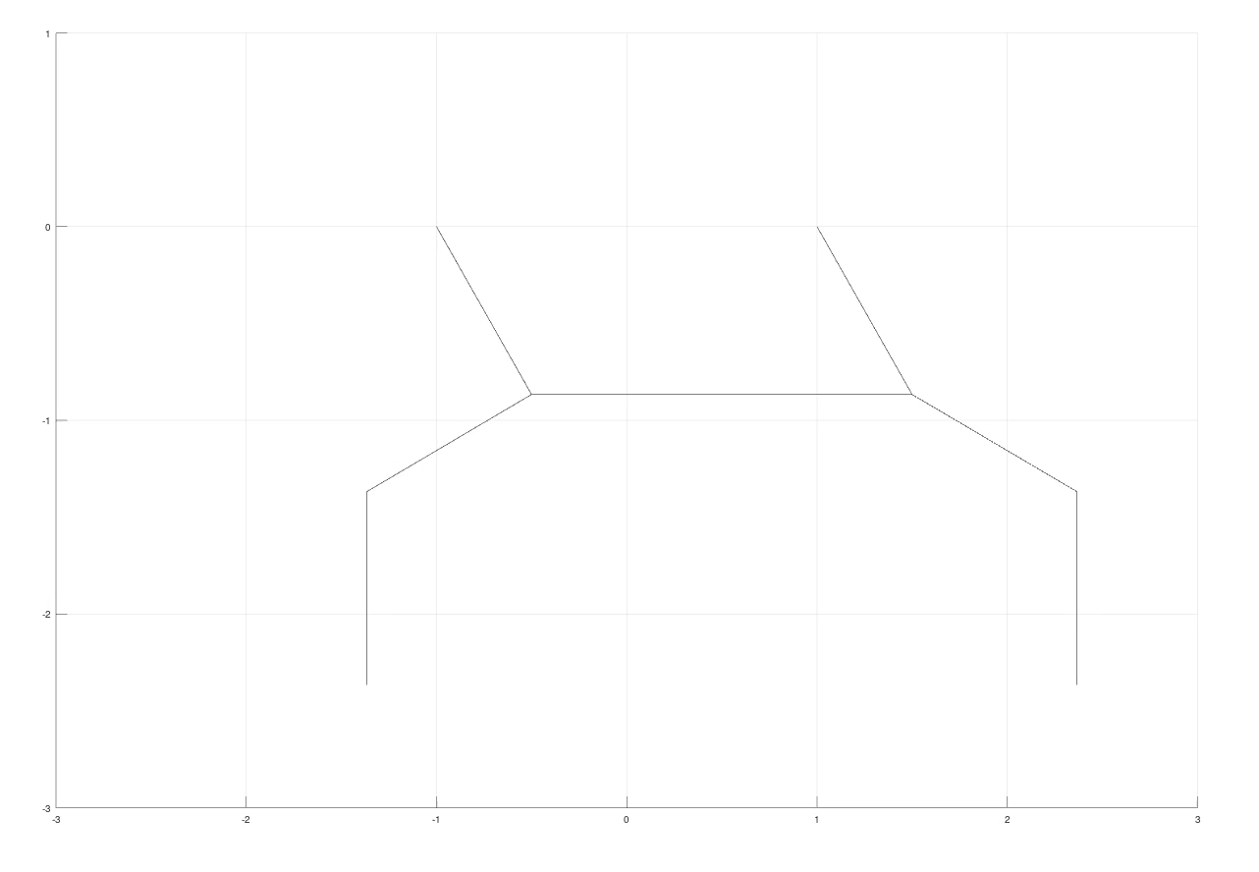
Further implementations of SHAKE’s algorithm Two double pendulums with Coulomb’s interactions

Slide 10
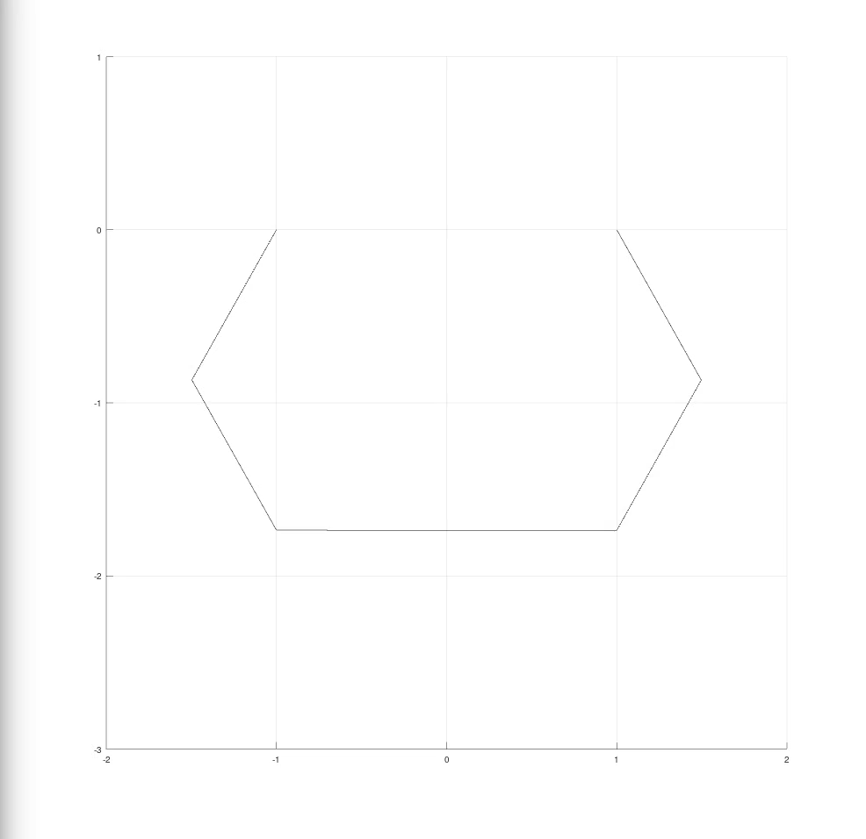
Further implementations of SHAKE’s algorithm Squared pendulum with non symmetric masses

Slide 11
Thank you
Manfred Nesti
Luca Caivano
Bruno Ursino
Alessandro Pegurri
Valeria Pajola
Chiara Vitale
Andrea Della Libera

